Slide 1
COMP490 Final Year Project Final Presentation
Spaced practice with study progress tracking for children
Academic Year 2022/23
Project number: | 21
Student ID: | P-19-0833-2
Student Name: | Daniel Ruan
Supervisor: | Philip Lei
Assessor: | Wilson Ho
Presentation panel: | Charles Lam

Slide 2
1
2
3
4
5
Presentation Outline
Introduction
Objectives
Methodology
User test Result
Conclusion
2

Slide 3

Introduction
The project aims:
To determine an appropriate spaced practice algorithm through research and previous study review.
To design and build a user-friendly web application for children to learn and practice of general knowledge.
3

Slide 4
Objectives
Conduct a thorough review of existing literature on spaced practice and progress tracking methodologies.
Design and implement a spaced practice algorithm that generates personalized practice exercises for subsequent learning sessions, considering schoolchild mastery, individual characteristics, and an appropriate balance of reviewed, weak, and new topics.
Develop an intuitive, user-friendly web application designed to support users in their learning journey and generate relevant after-class exercises. Track learning progress by automatically grading exercises and gathering performance data.
4

Slide 5
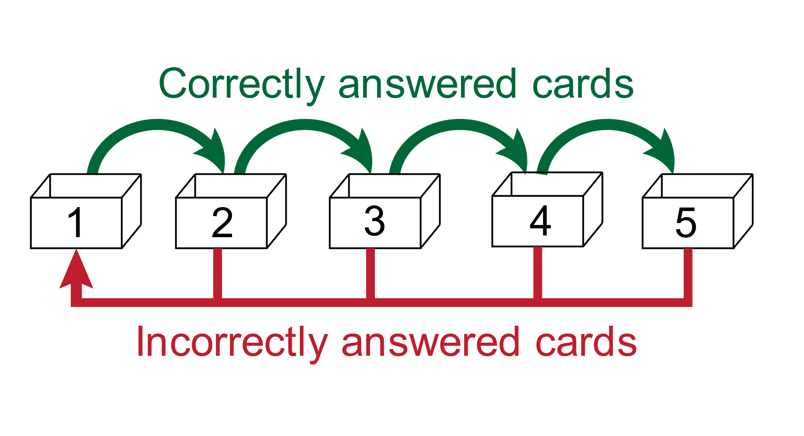
Methodology
Leitner boxes System
5

Slide 6
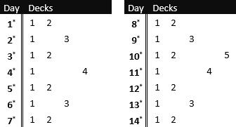
Algorithm
Classify all questions based on the user's familiarity with each question
Use the improved Leitner calendar to determine the content students need to review on that day
Leitner boxes System
The improved Leitner calendar
After users complete the exercises, upload their answers and update the familiarity status of the questions
Generate a daily exercise list
Spaced Practice Algorithm
6

Slide 7
System Design
Client side website
Vue3 + Typescript
MVVM model
Data Content-Management-System
Strapi + JavaScript
Upload data & create APIs
Front-end
RESTful APIs over HTTPS
Data request / response
Back-end
Back-end infrastructure
SQLite 3 & NodeJS & Strapi integration
Relational Database
Software Architecture
7

Slide 8
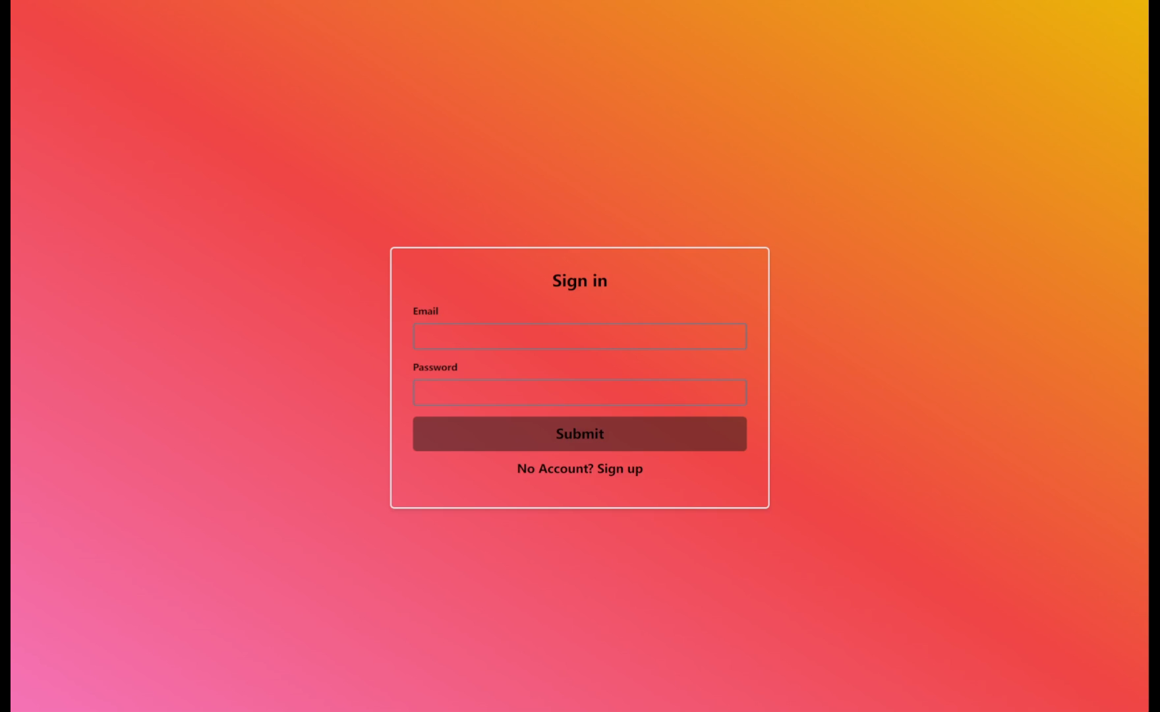
System Demonstration
8

Slide 9
User Test Result
Control group: used the conventional learning methods for learning.
Experimental group: used the spaced practice system for learning.
Experimental results: using this project as a spaced practice system can effectively reduce the forgetting of students during the learning process and improve their performance in the final test.
8

Slide 10
Conclusion
Overall, this project has implemented a Vue3 web application that provides a digital platform for school children to learn general knowledge. It also combines the efficient learning algorithms from spaced practice to create customized learning plans for each student. By incorporating personalized revision and adjusting review strategies, it reduces knowledge forgetfulness and thus increases learning efficiency.
9

